Slide 1


6224
Bachelor of Arts and Sciences in Applied Artificial Intelligence

Slide 2

About School of Computing & Data Science (CDS)
Empowering Changemakers of the Future
▪ ▪
Newly established school at The University of Hong Kong Encompasses the Department of Computer Science and the
Department of Statistics and Actuarial Science
Aims to foster innovation, collaboration, and excellence in the vital fields of
▪
- - - -
Computing Statistical Sciences Data Science Artificial Intelligence

Slide 3




International rankings
of HKU
#1
#11
in Asia (2026)
in the world (2026)
#18
Data Science and Artificial Intelligence (2026)
#6
#33
in Asia (2026)
in the world (2026)

Slide 4




6224 Applied Artificial Intelligence
Introduction

Slide 5
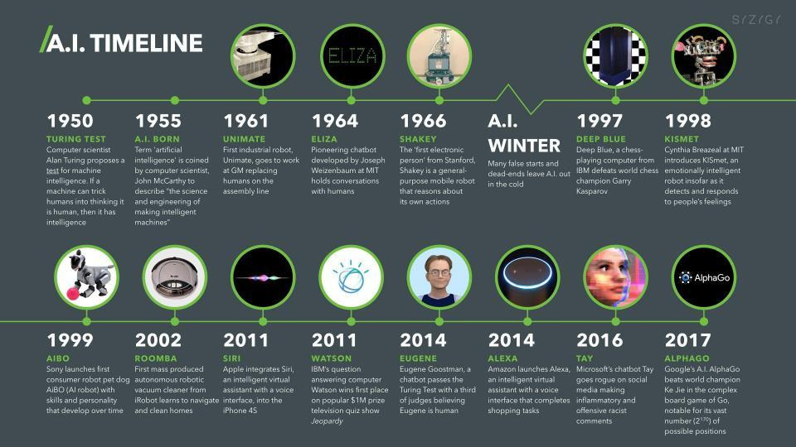

6224 Applied Artificial Intelligence
AI History
2022

Slide 6
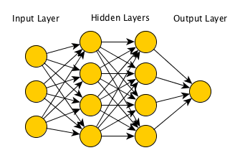

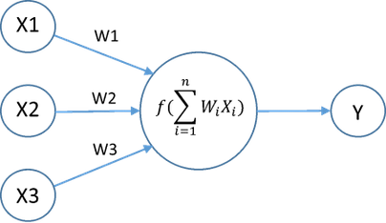

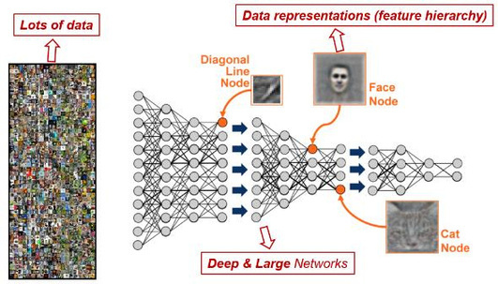
6224 Applied Artificial Intelligence
The Success of AI
Neural Network
GPU A100
Deep Learning

Slide 7










6224 Applied Artificial Intelligence
Bachelor of Arts and Sciences (Applied AI)
Interdisciplinary programme co-offered by:

Slide 8
6224 Applied Artificial Intelligence
Curriculum Structure & Course Selection

Slide 9






6224 Applied Artificial Intelligence
General Structure
Forty 6-credit courses spanning over 4 years of full-time study
(240 Credits)
UNIVERSITY EDUCATION
2ⁿᵈ MAJOR / MINOR(S) / ELECTIVES
Remarks:
  Language Courses
  Common Core Courses
  AI Literacy Courses
Programme Core: MUST take
(42 credits)
(84 credits)
⚫
⚫
1 course = 6 credits
1 semester = 30 credits
⚫
= 5 courses
PROGRAMME CORE
Variations are possible
BASc
⚫
(± credits)
  Core Courses
  Concentration
  Electives
  Capstone Course
CORE COURSES
⚫
Total number of credits CANNOT exceed 288 credits
(18 credits)
(96 credits)

Slide 10



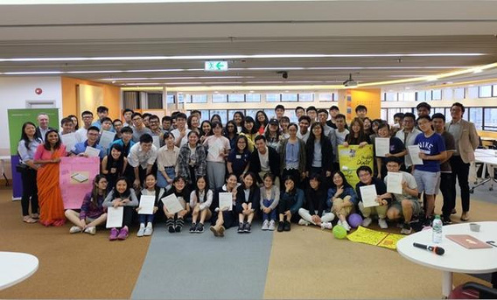









6224 Applied Artificial Intelligence
BASc Core Courses (18 credits)
BASC9001 Approaching interdisciplinarity: knowledge beyond disciplines
BASC9002 Leadership in practice: project-based approaches to interdisciplinary challenges SDST1016 Data science 101
Multidisciplinary training in leadership, design thinking
Introduction to foundations of human
knowledge and data science
Networking with fellow students from other BASc programmes

Slide 11
6224 Applied Artificial Intelligence
Language Enhancement Courses – English Courses
CAES1001 Academic communication in English
    Students who achieved Level 5 or above in English Language in HKDSE are exempted from taking this course
    For the list of equivalent qualifications, please refer to Division’s first year student handbook 2026-27
    For non-local students with qualifications not listed in the aforesaid equivalent qualification list, you can apply the exemption by taking Academic Speaking and Writing test conducted by CAES.
CAES9821 Professional and technical communication for statistical sciences
    1ˢᵗ Semester or 2ⁿᵈ Semester of Year 2

Slide 12
6224 Applied Artificial Intelligence
Language Enhancement Courses – Chinese Courses
Local Students: To be advised in Year 3
Putonghua-speaking Students:
CUND9001 / CUND9002 / CUND9003 / CUND9004
International Students:
“Chinese Language” CHIN9501 and CHIN9511 or “Chinese Culture” CHIN9521 and CHIN9522
Please refer to Division’s first year student handbook 2026-27

Slide 13
6224 Applied Artificial Intelligence
Common Core Courses
Unless otherwise prescribed in the curriculum regulations and syllabuses, students are required to successfully complete 24 credits in the Common Core Curriculum, comprising 6 credits from any four different Areas of Inquiry. Students are not allowed to take more than 24 credits of Common Core courses within an academic year, except for students who are required to make up for failed credits as well as those who take courses offered in the summer semester which are optional. In addition, Common Core courses cannot be taken as free electives.
There are five Areas of Inquiry (AoIs):
    Scientific and Technological Literacy (course code: CCSTxxxx)
    Arts and Humanities (course code: CCHUxxxx)
    Global Issues (course code CCGLxxxx)
    China: Culture, State and Society (course code: CCCHxxxx)
    Artificial Intelligence (course code: CCAIxxxx)

Slide 14
6224 Applied Artificial Intelligence
UGRE1001 Introduction to the Constitution, the Basic Law and the National Security Law
  This is a non-credit bearing course which is required by the University under Regulation UG5(f) of the Regulations for First Degree Curricula as part of the graduation requirements for all current Full-time and Part-time Undergraduates. New students can start to take this course after September 1, 2025.
  This course aims to provide a basic introduction of the Constitution, the Basic Law and the National Security Law. You can access the link at CEDARS-General Education for the information on this course. Please click here to access the “UGRE1001 Student Guide” on instructions for access to the course. (Login to HKU Portal is required.)
  Please refer to the page here for any latest updates on this course.

Slide 15
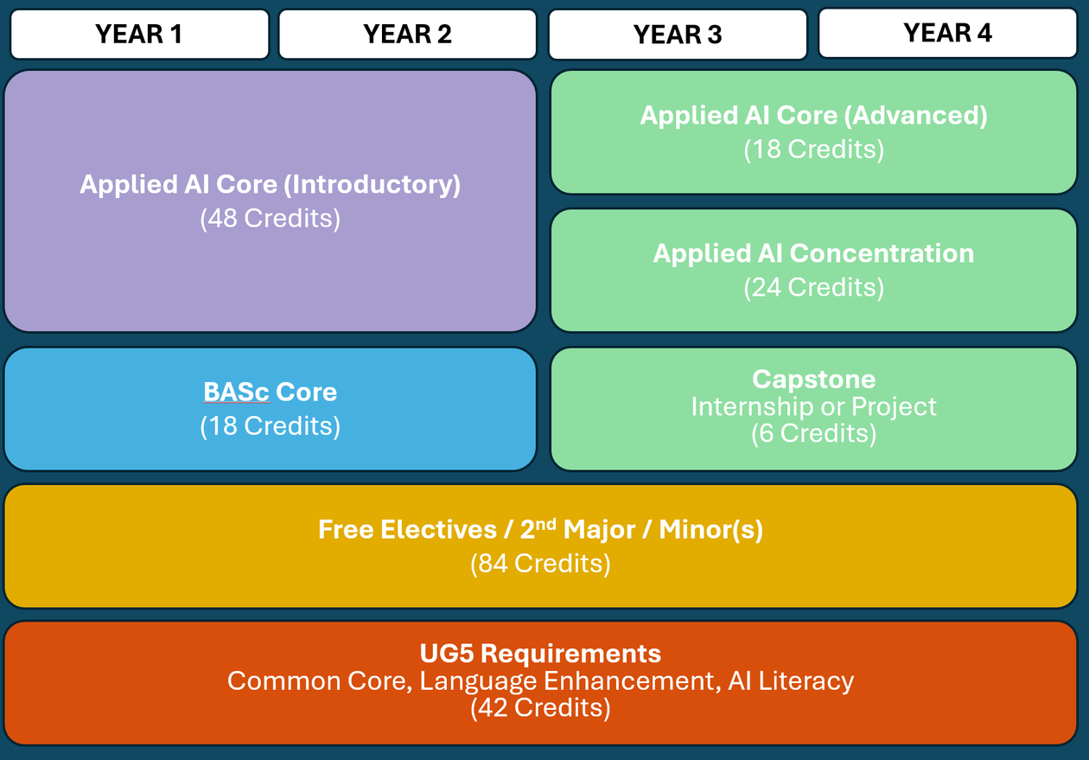
6224 Applied Artificial Intelligence
Suggested Study Plan

Slide 16
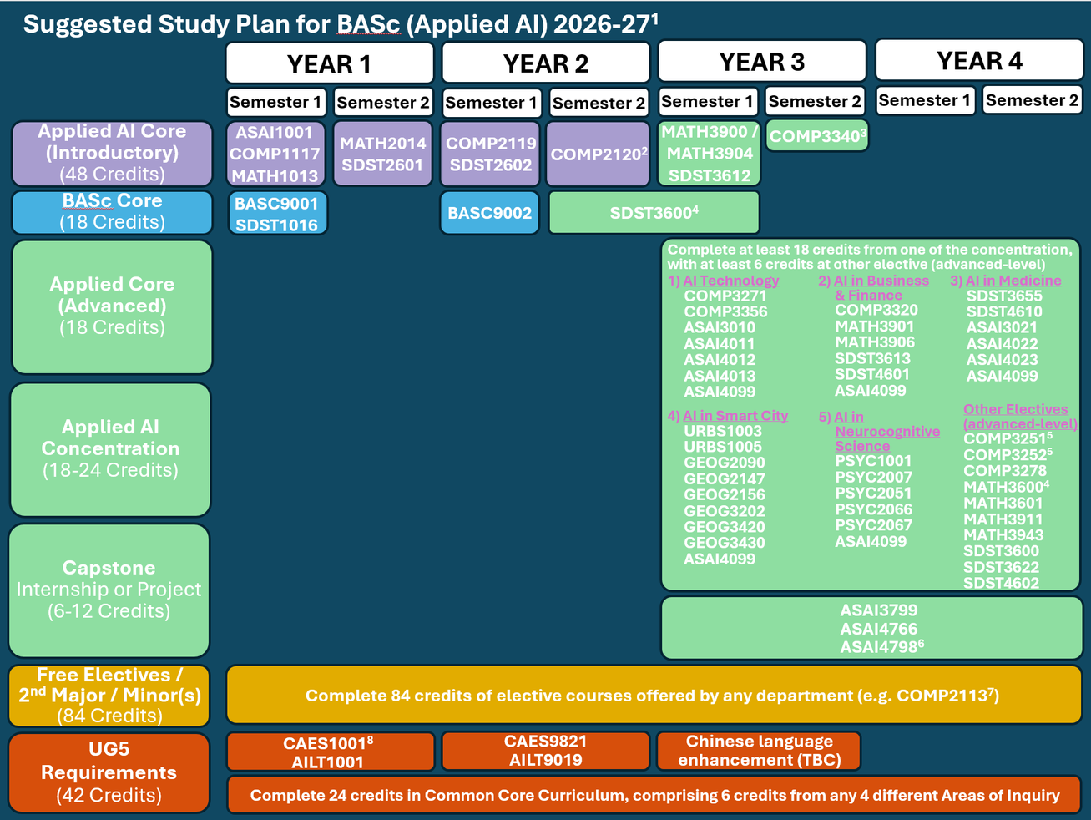
6224 Applied Artificial Intelligence
Suggested Study Plan
Notes:
16

Slide 17
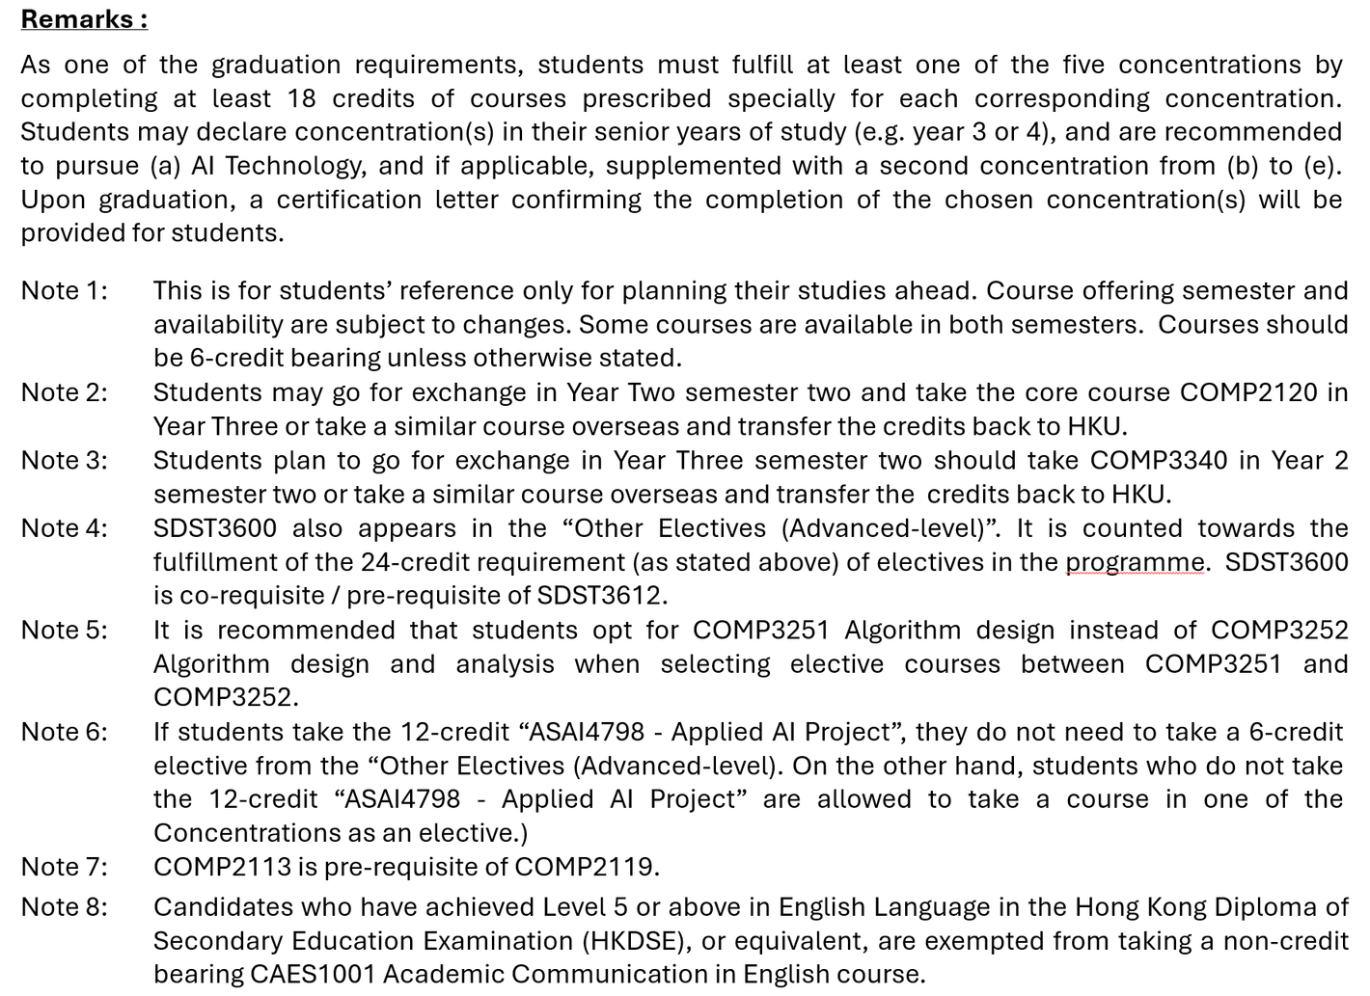
6224 Applied Artificial Intelligence
Suggested Study Plan

Slide 18








6224 Applied Artificial Intelligence
Course Structure of AI Programme
Statistics/ Mathematics
Computer
programming
Machine learning/ Deep learning
Computer
Computer
Natural language
High-performance
AI, ethic, law and beyond
graphics
processing
Robotics
vision
computing
Medicine
Business and
Smart city
Neurocognitive
finance
science

Slide 19

6224 Applied Artificial Intelligence
Academic Integrity
Plagiarism is a serious offence in the academic world. It constitutes academic theft – the offender has ‘stolen’ some intellectual property and presented it as his or her own. Plagiarism speaks to a person’s integrity and honesty, stifles creativity and originality, and defeats the fundamental purpose of education.
In this University, plagiarism is a disciplinary offence. Any student who commits the offence may face disciplinary action. It is the responsibility of all students at all levels to familiarize themselves with proper academic practice of writing, citation and referencing. For detailed information about plagiarism, please visit the website at https://tl.hku.hk/plagiarism/.

Slide 20

6224 Applied Artificial Intelligence
Progression and Discontinuation
Unless otherwise permitted by the Board of Studies, students will be recommended for discontinuation of their studies if:
    They fail to complete successfully 36 or more credits in two consecutive semesters (not including the summer semester), except where they are not required to take such a number of credits in the two given semesters; or
    They fail to achieve an average Semester GPA of 1.0 or higher for two consecutive semesters (not including the summer semester); or
    They have exceeded the maximum period of registration specified in the Regulations for the Degree of BASc(Applied AI).

Slide 21

6224 Applied Artificial Intelligence
Disciplinary Matters
    The University upholds the highest standards of academic integrity
    Apart from plagiarism, cheating or misconduct by the student will be considered by the Disciplinary Committee
    The Committee will decide the penalty on each case, ranging from reprimand, suspension of studies or even expulsion from the University depending on the seriousness of the offence

Slide 22

6224 Applied Artificial Intelligence
Regulation and Syllabus for BASc(AppliedAI)
Please refer to the Regulation and Syllabus posted on the Division website at https://www.csai.cds.hku.hk/

Slide 23
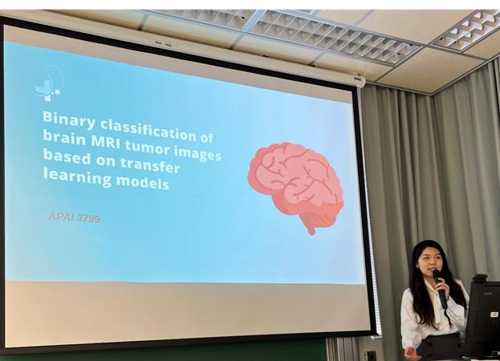
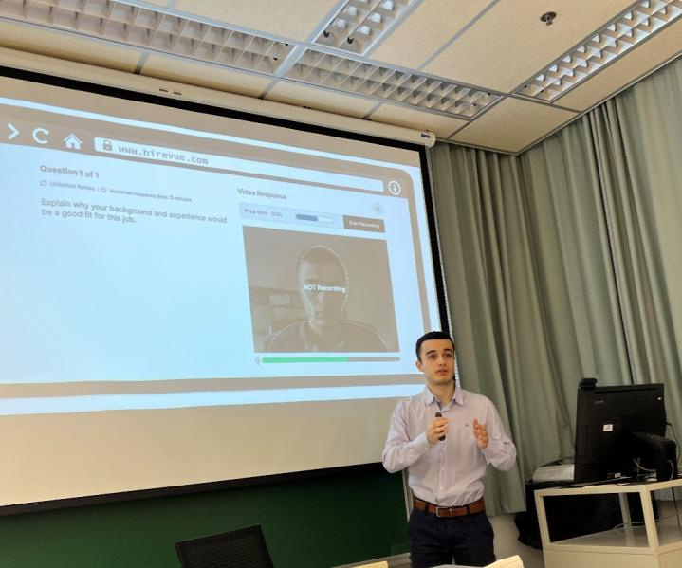
6224 Applied Artificial Intelligence
Capstone AI Projects
Generalizable machine learning technology with application in medical image analysis
AI Video Analytics Tool for Human Behavioural Intelligence

Slide 24
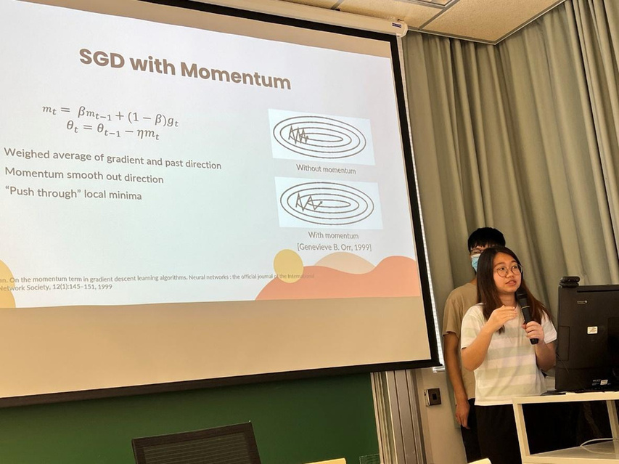
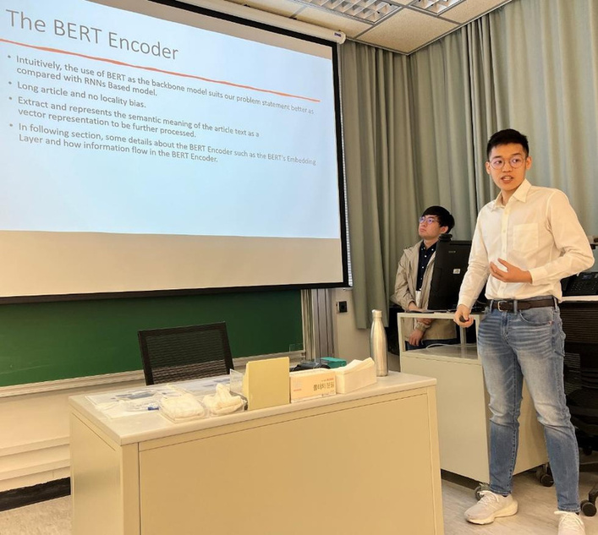
6224 Applied Artificial Intelligence
Capstone AI Projects
Generalizable training algorithms for deep learning based image Classification
PredictionofStockReturns from Social Media
Using Deep Learning

Slide 25
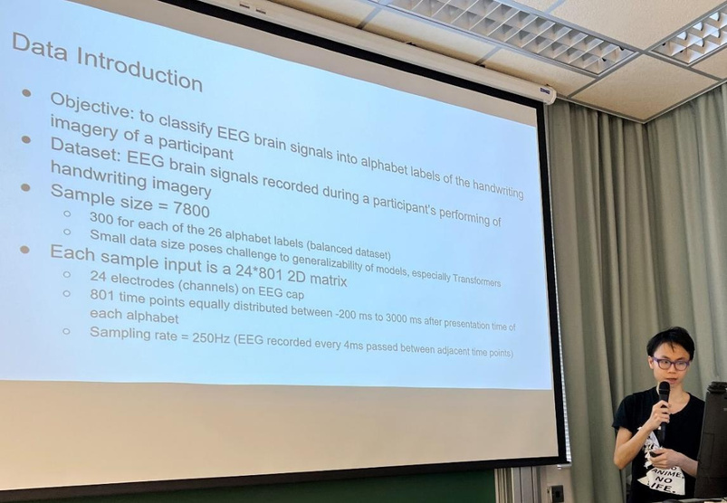
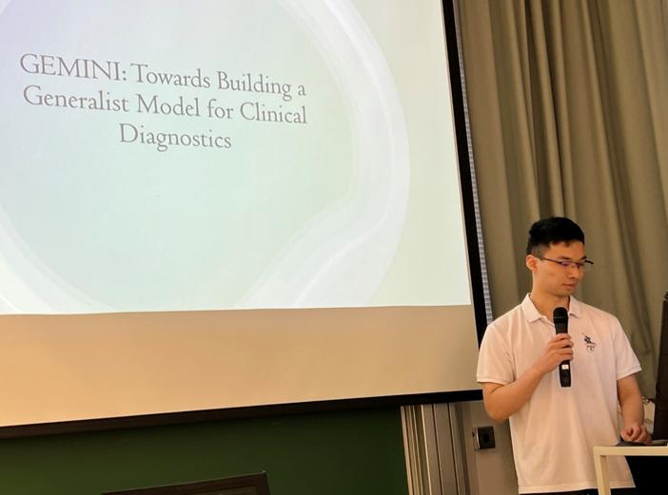
6224 Applied Artificial Intelligence
Capstone AI Projects
Recognition of imagined handwritten content from brain signals

Slide 26
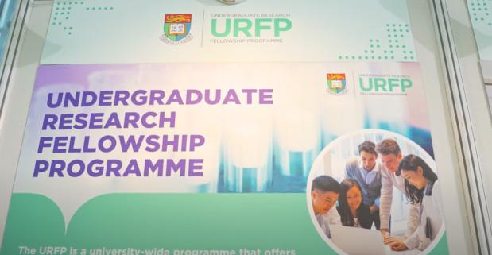
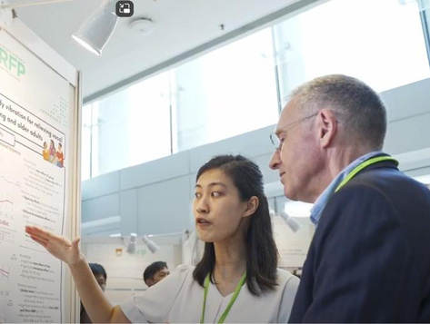
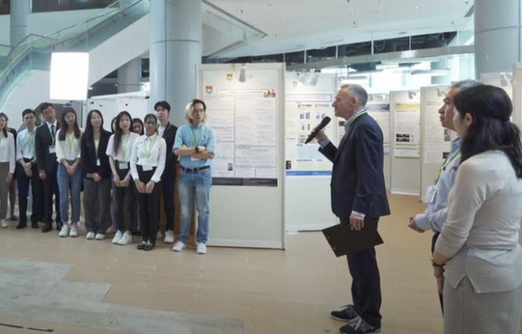
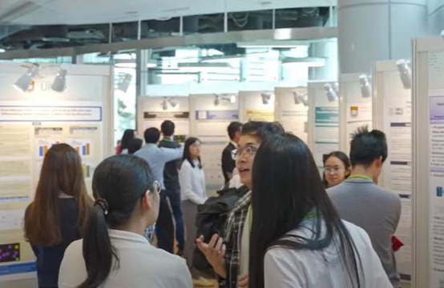
6224 Applied Artificial Intelligence
Undergraduate Research Opportunities
Undergraduate Research Fellowship Program (URFP)

Slide 27




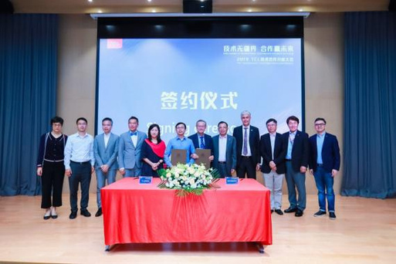





6224 Applied Artificial Intelligence
Support for Internships
Partner with Industrial Leaders (in year 3 or year 4)

Slide 28

6224 Applied Artificial Intelligence
Other Useful Information
Academic Advising and Scholarships Office
https://aas.hku.hk/
Academic Support and Examinations Section, Registry
https://www.ase.hku.hk/
CEDARS
https://cedars.hku.hk
HKU Co-operative Education Programme (Co-oP@HKU)
https://co-op.hku.hk/
Examinations Office
https://www.exam.hku.hk/
Information Technology Services & Student Information System
https://www.its.hku.hk/
University Health Service (UHS)
https://www.uhs.hku.hk/
Equal Opportunity Unit
https://www.eounit.hku.hk/en
Future Readiness Online Courses
https://fri.hku.hk/online-modules/

Slide 29


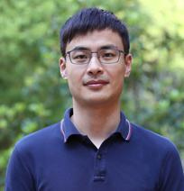
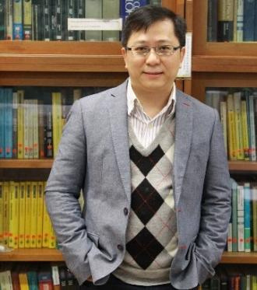

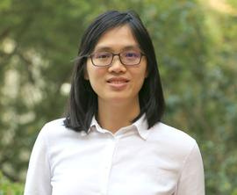

6224 Applied Artificial Intelligence
Who’s who?
Programme Co-Directors
Prof. Lequan YU
(AI & Data Science, RRS 226)
Prof. Patrick NG (Mathematics, RRS 424)
Associate Programme Directors
Prof. Liangqiong QU
(RRS 121)
Prof. Yuenwen LEI
(RRS 319)

Slide 30
6224 Applied Artificial Intelligence
Thank you!
Contact us
Email: app6224@hku.hk

